Slide 1


Big Data Content Analytics
Spring Term 2018-2019
OCR - Invoicing Process

Slide 2
Agenda
Introduction
Our Approach
Demo 1: Manual Approach
RPA Overall Design
Demo 2: Automation
Database/ ERP Workflow
Monitoring/ Reporting
Notes:
To provlima tou invoicing stis etaireias to as is kai tin dikia mas prosegkisi
Demo

Slide 3
Introduction

Slide 4



Who we are
Dimitris Papadoulis
Data Scientist
Konstantinidis Antonis
Business Analyst
Kyrgiou Angeliki
Development Operations Engineer
Notes:
Angeliki: Axolithike me to komati Robotic Process Automation(RPA)
Dimitris: Machine learning tou montelou
Egw: Data warehousing, Analysis and reporting

Slide 5

Structure
Main Roles and Project Team Structure
Main Roles
Data Scientist
Development & Operations Engineer
Business Analyst
Development
Convolutional Neural Networks for image classification
Feed forward Neural Networks for language prediction
Implementation of Flask Microframework
Robotic Process Automation
Download attached invoices from Outlook
Upload invoices to Flask Application
Dashboard and Report Monitoring
Database Creation
Create Dashboards and Monitoring Reports in Power BI
Notes:
DEV:Montelo 1 classify ta timologia
Montelo 2 languge detection kai stin sunexeia tha deiksoume akrivos ti roi
RPA: Pws mporoume na automatopoiisoume tin diadikasia xwris ton anthrwpino paragwnta
Report: Reporting and Monitoring

Slide 6
Project Time Plan
Actions required to achieve OCR implementation
Activities | June ‘19 | July ‘19 | August ‘19 | September ‘19
Data Modelling
Establishment of Business Requirements
Tool and Code selection
Model data/ define common data dimensions and facts
Design the Prototype OCR Report in PowerBI
Setup Environments
Pycharm
BluePrism
Development
Transformation of PDF to JPEG
Image Classification
OCR
Language Prediction to Text
Integrated in Flask Application
RPA
Establishment Connection with DB
Create Dashboard and Reports in Power BI
Report
Presentation
Implementation in Python, automation with BluePrism and Dashboards in Power BI
Legend
Project Team
Business Analyst
Data Scientist
Development & Operations Engineer
Notes:
Endiktika to timeplan Machine learning data scientist logo tis poliplokotitas tou montelou

Slide 7
Our Approach

Slide 8
Our understanding of your needs
Delivered in the context of business and industry, science makes the difference
As-Is Invoicing Process
To Be Invoicing Process
deep dive follows in next chapter
Operations Department receives n invoices via email and saves them in a specific folder
Every morning a robot informs with email the Operations Department and Accounting Departments that the invoicing process is initiated
Specialized staff implements the necessary validation checks in the invoices and manually stores the data in an excel file, Access or SAP
The robot checks the inbox for emails with attached invoices which downloads to a specific folder
All the data are transferred massively to a database for monitoring reasons and pending for approval
The robot uploads the invoice to AUEB Invoicer
Employee from Operations sends the invoice(s) to Accounting Department to perform the payment
AUEB Invoicer retrieves the invoicing data, cross validates them with VIES and stores them in a database
AUEB Invoicer informs the Accounting Department that the database is updated with new ivoices
A revolutionary and modern solution that combines OCR and AI that leads to cost, time and human error reduction
User friendly reporting and monitoring tool, as Power BI enables users in self-service data discovery
Benefits
8

Slide 9


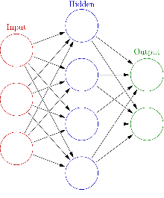





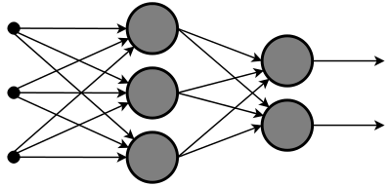





Python Integration
CNN model predicts in which category (company) our input belongs to
User hits upload for the process to begin
JPG
Invoice in jpg is changed to grayscale color and then is converted
to an numpy array (0,255)
Numpy array is used as an import to our already trained CNN classification model
Invoice in pdf format is selected by user and is passed to AUEB Invoicer with the help of the flask framework
Only the first page of the pdf is kept and the pdf is converted to jpg format
The OCR Google API is used to read the text from the invoice in jpg format using the English language
The OCR API is used again to read the text by using the correct language
VAT number is cross checked in VIES through selenium
Prediction: English language
The results are printed on the screen via flask web framework and a notification is sent to the user
Regular Expressions are performed in the text for the specific category that predicted and the results are returned in a list
The text is used as an import in our already trained feed – forward neural network
Regular Expressions are performed in the text for the specific category that predicted and the results are returned in a python list
Prediction: German language
Implementation in Python
Automation with BluePrism

Slide 10
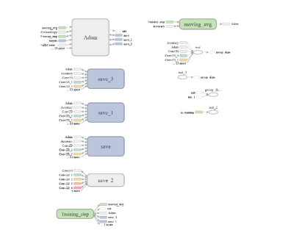
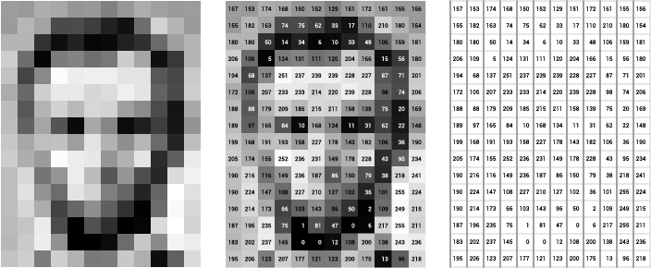
Convolutional Neural Networks: Image Classification
The journey to stronger, sustained outcomes
1
Convert image to array
3
Split dataset to train and test data
Put labels in each vendor
Import to model
[1,0,0,0,0]
[0,1,0,0,0]
[0,0,1,0,0]
[0,0,0,1,0]
[0,0,0,0,1]
4
2

Slide 11
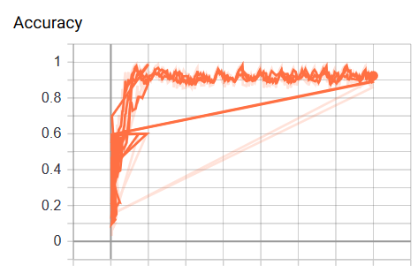
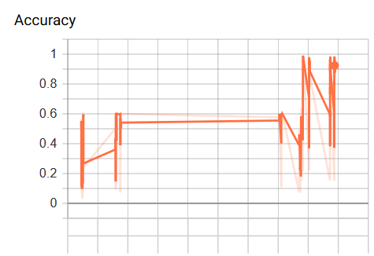
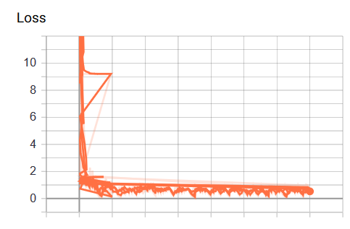
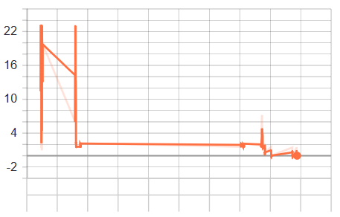
Model 1: Convolutional Neural Networks: Image Classification
Model Outcomes
Validation Accuracy
Validation Accuracy
Progress Overtime with different parameters *
Validation Loss
* E.g. learning rates, epochs, layers, activation functions
Validation Loss
11

Slide 12
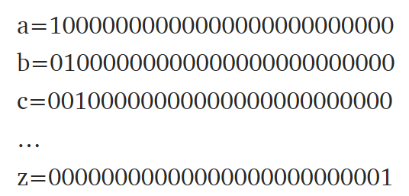
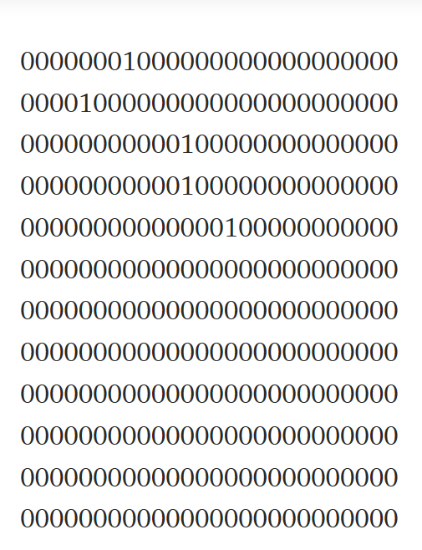
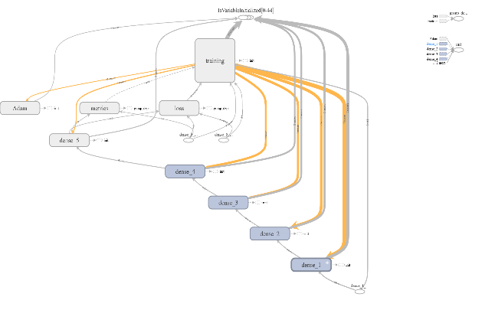
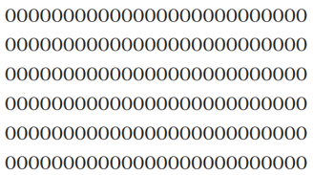
Feed Forward Neural Networks: Language Prediction
The journey to stronger, sustained outcomes
1
Convert the letters of each word to vectors
3
4
Labeling
Bind steps 1 & 2
[1,0] for English
[0,1] for German
Representation of the word “Hello”
Import to model
5
2
12

Slide 13
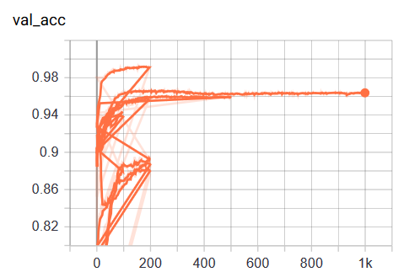
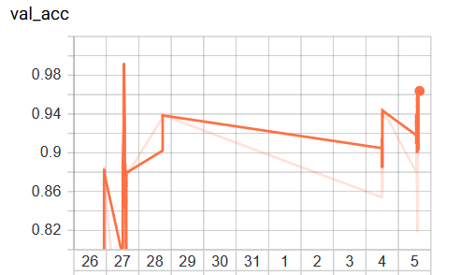
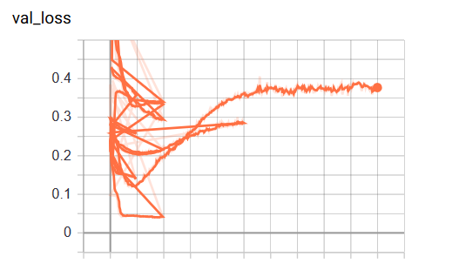
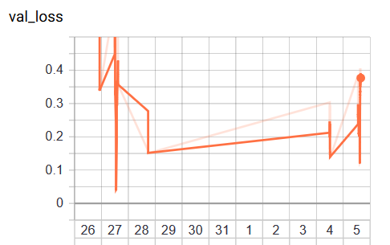
Model 2: Feed Forward Neural Networks: Language Prediction
Model Outcomes
Validation Accuracy
Validation Accuracy
Progress Overtime with different parameters *
Validation Loss
* E.g. learning rates, epochs, layers, activation functions
Validation Loss
13

Slide 14
Demo 1: Manual Approach

Slide 15
RPA Overall Design

Slide 16


RPA Architecture Design
App. 1 (Prod.)
App. 2 (Prod.)
App. 3 (Prod.)
6
1
Admin Machines
2
3
4
BluePrism Interactive Clients
BluePrism Runtime Resources
BluePrism Application Server(s)
5
Database Server
Control & Monitor
Control Robots
Schedule Robots
Production Environment
Legend
Virtual Machine
Interactions
16

Slide 17
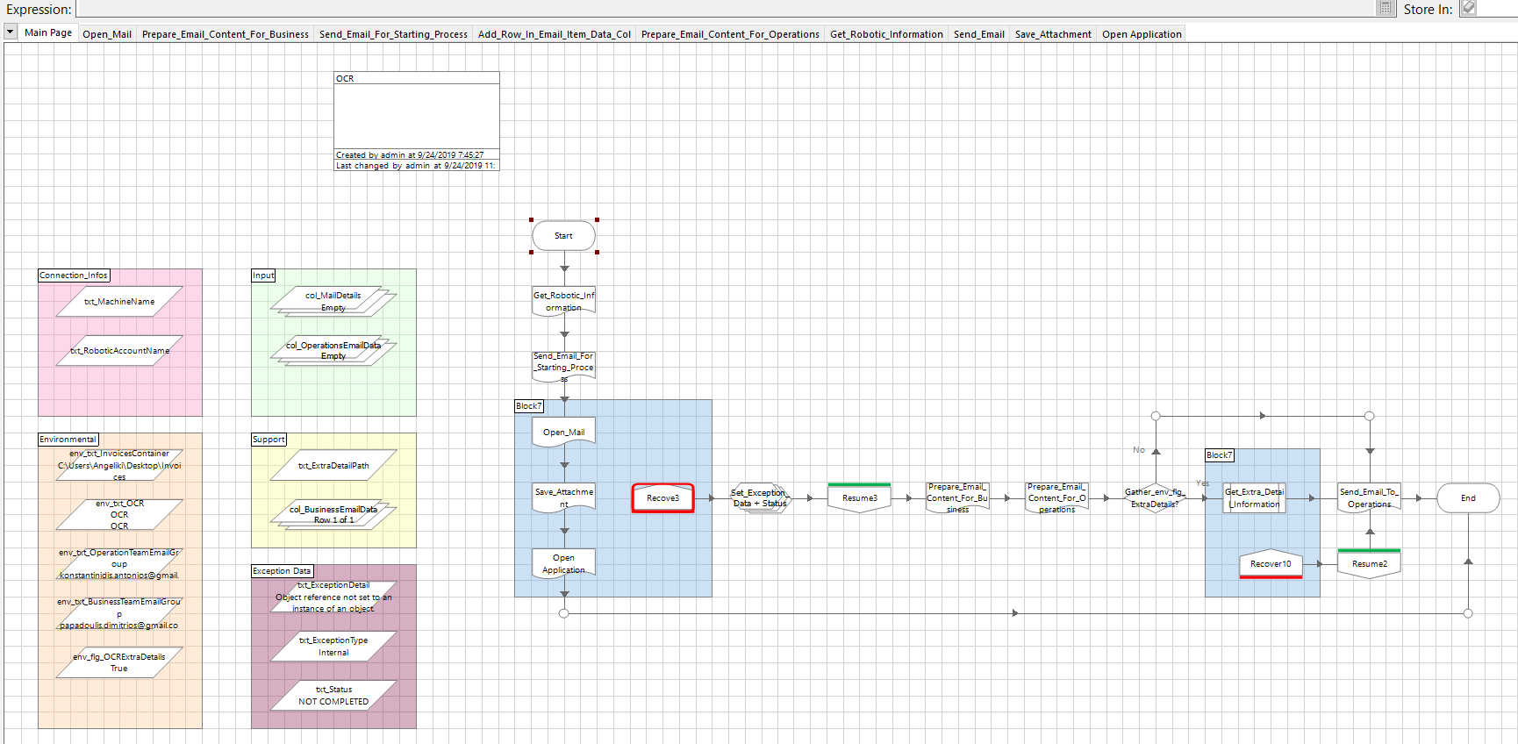
Process Main Page
17

Slide 18
Demo 2: Automation

Slide 19
Database/ERP workflow

Slide 20
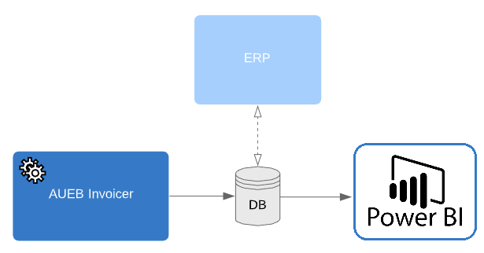

Proposed ERP/Workflow
Database/Entity-Relationship Diagram
Star Schema
1 Fact table 6 Dimension Tables
All Transactions
Currency Rates from European Central Bank
Extract Invoice Data and Load to DB
Changes, Update Invoice status (Pending/Approved/Rejected) and checking procedure through an ERP
Connect DB with Power BI for monitoring/reporting

Slide 21
Monitoring/Reporting

Slide 22
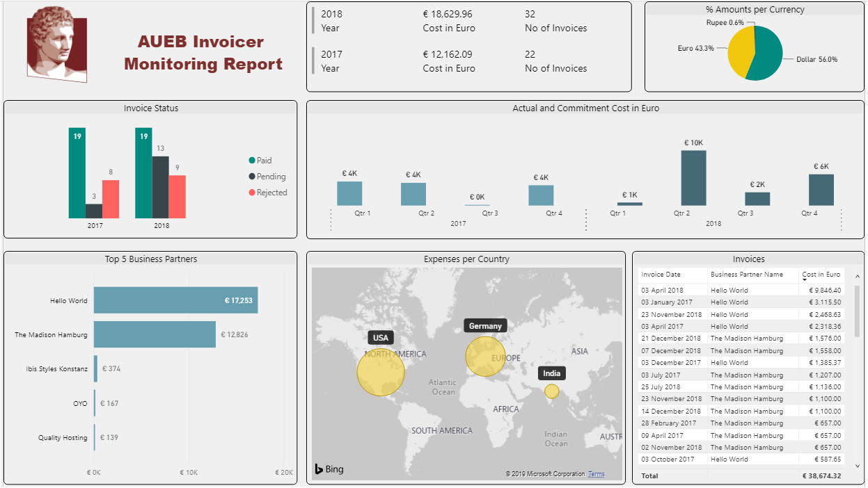

Monitoring/Reporting of Expenditures
Useful information and insights
Trend analysis
Vendor analysis

Slide 23
Future Work

Slide 24

Future Work
Capability of capturing elements outside predefined format
Response Optimization
Batch Invoice processing
Robot cross validates invoice data
24

Slide 25
Thank you!

